Slide 1

Mind Map of Lecture
Senescence
Endoplasmic
Pterostilbene
Autophagy&
Aging
Senolytics
Glymphatics
TUDCA

Slide 2
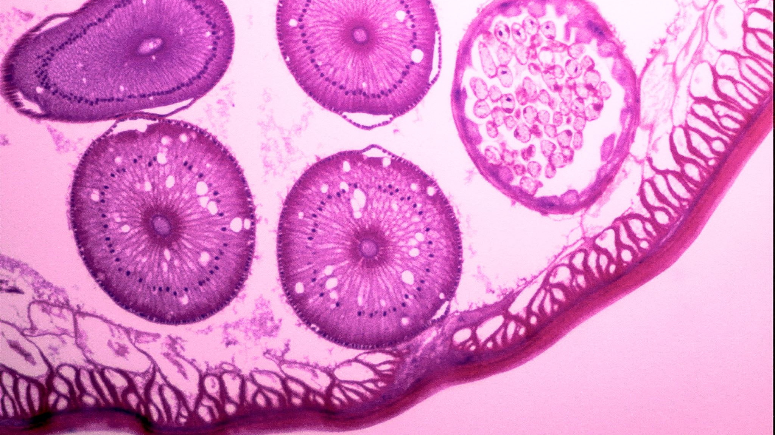
What is Senescence in Physiology?

Slide 3
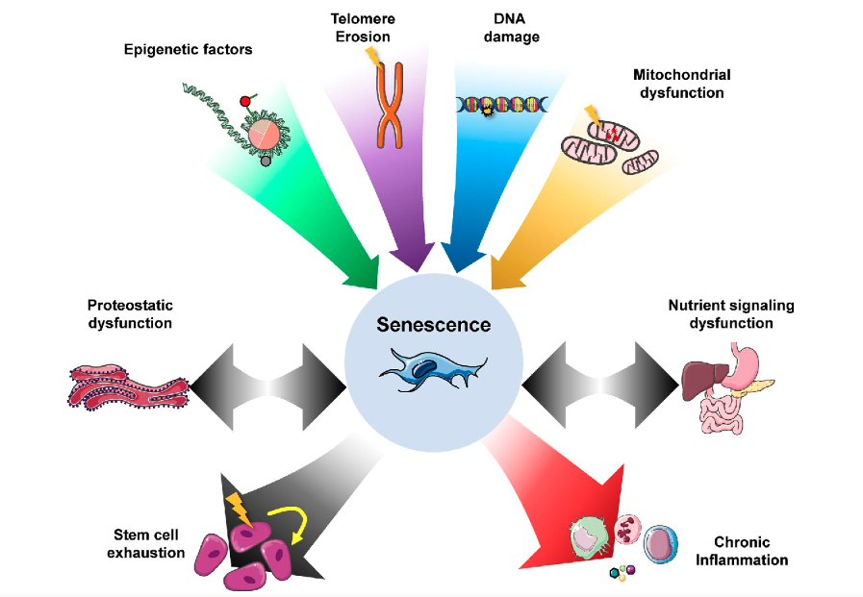
Senescence as a Central Hallmark of Aging
McHugh D, Gil J. Senescence and aging: Causes, consequences, and therapeutic avenues. J Cell Biol. Jan 2 2018;217(1):65-77.
Notes:
Telomere damage, DNA damage, and mitochondrial dysfunction are primary drivers of damage in aging. Many of these damaging factors can induce senescence.
Senescence can in turn drive further damage such as stem cell exhaustion and chronic inflammation. Other responses to damage, such as proteostatic dysfunction and nutrient signaling disruption, are also integrally linked with the senescence response. Adapted from López-Otín et al. (2013).
proteostatic dysfunction = errors in regulation of protein translation, chaperone-assisted protein folding and protein degradation. The classic examples are missense mutations (a DNA change that results in different amino acids being encoded at a particular position in the protein) and deletions that change the thermodynamic and kinetic parameters for the protein folding process.

Slide 4
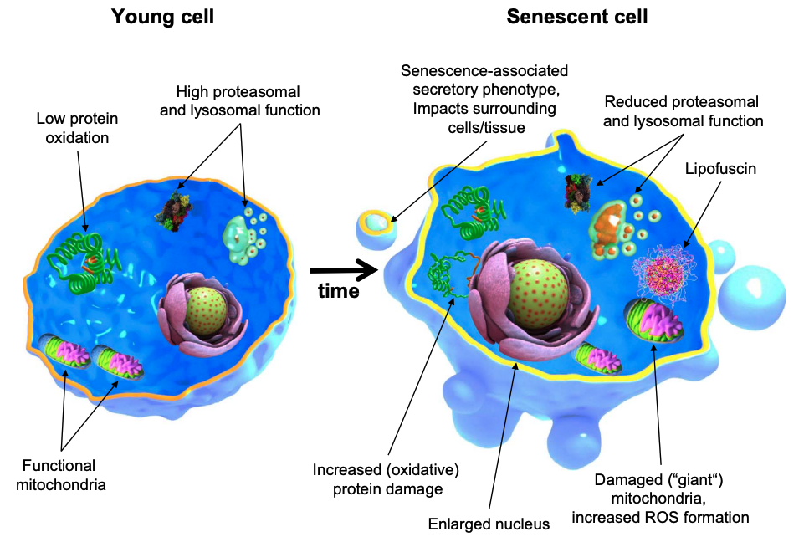
Cellular & Molecular Features of Young & Aged Cells
Höhn A, et al. Happily (n)ever after: Aging in the context of oxidative stress, proteostasis loss and cellular senescence. Redox Biol. Apr 2017;11:482-501.
Notes:
Senescence was originally identified by the finite lifespan of normal cells that is a consequence of telomere shortening with each cycle of DNA replication.
Comparing to young cells, aged cells often exhibit marked features. For example, it is known that their nucleus is often enlarged. Their proteolysis mechanisms suffer a major reduction in functionality, found by evaluating the activity of both proteasomal and lysosomal mechanisms. The consequence is the accumulation of oxidized proteins and the formation of insoluble material such as lipofuscin, a hallmark of aged cells as well and altogether contributing to a loss in cellular proteostasis. Furthermore, recent years have brought us evidence of a secretory phenotype acquired by senescent cells (SASP), which is characterized by the release of several inflammatory cytokines into the surrounding cells and tissues, resulting in low-grade chronic inflammation over time causing tissue and organism dysfunction.
By the way, Adult stem cells also become dysfunctional with age, displaying evidence of senescence

Slide 5
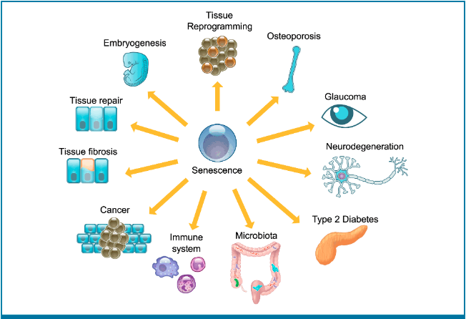
Consequences of Cellular Senescence
Calcinotto A, et al. Cellular Senescence: Aging, Cancer, and Injury. Physiol Rev. 2019;99(2):1047-1078.
Notes:
Cellular senescence is a permanent state of cell cycle arrest that occurs in proliferating cells subjected to different stresses. Senescence is, really, a cellular defense mechanism that prevents the cells from acquiring an unnecessary damage.
Now the senescent state is accompanied by a failure to re-enter the cell cycle in response to mitogenic stimuli, an enhanced secretory phenotype and resistance to cell death. Senescence takes place in several tissues during different physiological and pathological processes such as tissue remodeling, injury, cancer, and aging. Although senescence is one of the causative processes of aging and it is responsible of aging-related disorders, senescent cells can also play a positive role. In embryogenesis and tissue remodeling, senescent cells are required for the proper development of the embryo and tissue repair. In cancer, senescence works as a potent barrier to prevent tumorigenesis. Therefore, the identification and characterization of key features of senescence, the induction of senescence in cancer cells, or the elimination of senescent cells by pharmacological interventions in aging tissues is gaining consideration in several fields of research.

Slide 6

Autophagy
Autophagy is the body’s way of cleaning out damaged cells, in order to regenerate newer, healthier cells within the cell itself
Impaired Autophagy leads to Aging and Senescecne

Slide 7
Glymphatic System
Glymphatic system function
The glymphatic system is a network that clears metabolic waste and proteins from the brain. When the glymphatic system is impaired, waste and proteins build up in the brain, which can lead to neurodegenerative diseases and cognitive decline.
The glymphatic system's role in clearing metabolic waste and proteins from the brain is linked to autophagy, a process that removes damaged mitochondria from cells

Slide 8
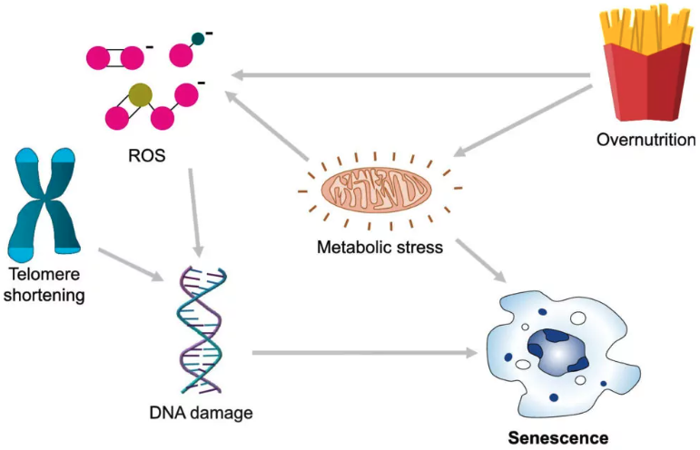
Triggers of cellular senescence and Impaired autophagy
Image Modified from Amaya-Montoya M, et al. Cellular Senescence as a Therapeutic Target for Age-Related Diseases: A Review. Adv Ther Apr 2020;37(4):1407-1424.
Notes:
Triggers of cellular senescence
Amaya-Montoya M, Pérez-Londoño A, Guatibonza-García V, Vargas-Villanueva A, Mendivil CO. Cellular Senescence as a Therapeutic Target for Age-Related Diseases: A Review. Adv Ther. Apr 2020;37(4):1407-1424.
Yes, metabolic disorders can impair autophagy:
Autophagy
A process that helps cells maintain homeostasis by degrading and recycling damaged or unneeded components.
Metabolic disorders
Conditions such as obesity, type 2 diabetes, and metabolic syndrome are associated with impaired autophagy.
Mechanisms
Autophagy efficiency declines with age and can be interfered with by overnutrition. In obese animals, nitric oxide (NO) can inhibit autophagy in the liver, which can lead to type 2 diabetes.
Glycogen storage disorders
These inherited metabolic disorders can cause abnormal autophagy, which can disrupt cellular metabolism and mitochondrial function.
Autophagy plays a vital role in regulating metabolism, which is closely linked to the development of metabolic syndrome. Autophagy can also have both protective and detrimental effects on cardiovascular disorders.
Relationship Between Autophagy and Metabolic Syndrome ...
Apr 15, 2021 — Autophagy is a lysosomal degradation process that plays an important role in maintaining cellular metabolic homeostasi...
NCBI
Autophagy in metabolic syndrome: breaking the wheel by ...
Feb 3, 2020 — Although autophagy is considered as a housekeeping cell process, abnormalities of autophagy have increasingly been asso...
Nature
Links between autophagy and disorders of glycogen metabolism
Nov 21, 2019 — The glycogen storage diseases are a group of inherited metabolic disorders that are characterized by specific enzymati...
National Institutes of Health (NIH) (.gov)
Show all
Yes, telomere shortening can impair autophagy:
Telomere shortening and autophagy
Telomere shortening is a factor in cellular aging that can impair autophagy. Telomere shortening is a result of DNA replication, which generates chromosomes with shorter telomeres. When telomeres are too short, they can't bind enough telomere-capping proteins, which activates the DNA damage response (DDR) pathways. This can lead to cellular senescence, which is a key contributor to aging and age-related diseases.
Autophagy and aging
Autophagy is a process that removes cytoplasmic contents, such as organelles and aggregated proteins. During aging, cellular factors associated with autophagy are compromised, which may contribute to age-related diseases.
Autophagy and other aging factors
Other factors that can impair autophagy include oxidative stress, DNA damage, and inflammation-associated secretory phenotype (SASP).
Pharmacological treatment
Pharmacological treatment to enhance autophagy has shown to improve disease in animal models.
Autophagy, Cellular Aging and Age-related Human Diseases - PMC
In this review, we have briefly described possible connections between impaired autophagy and factors in cellular aging. Causative...
NCBI
Telomere dysfunction in ageing and age-related diseases
Feb 14, 2022 — tDDR activation and TAF accumulation are often causally connected to other ageing-associated processes. These include ...
Nature
Autophagy, Cellular Aging and Age-related Human Diseases
Nov 27, 2019
Experimental Neurobiology
Show all

Slide 9
Fecal microbiota transplantation (FMT) is a procedure that involves transferring stool from a healthy donor to a patient's gut to treat neurological disorders. FMT has shown promising results in research on neurodegenerative diseases, including:
Alzheimer's disease (AD): FMT can improve cognitive function, reduce Aβ plaque burden, and reduce neuroinflammation. FMT can also reverse the disturbance of gut microbiota in AD mice and enhance learning and memory ability.
Parkinson's disease (PD): FMT can improve motor function, reduce dopaminergic neuron loss, and reduce tremor. FMT can also alleviate physical impairment in PD mice.
Amyotrophic lateral sclerosis (ALS): FMT can improve bowel function and ALS symptoms.
Notes:
Autophagy disruption
Some metabolites from the gut microbiota can disrupt autophagy, which can contribute to neurodegeneration.

Slide 10
Interventions in Senescence and Autophagy
Support the glymphatic system
Support autophagy

Slide 11
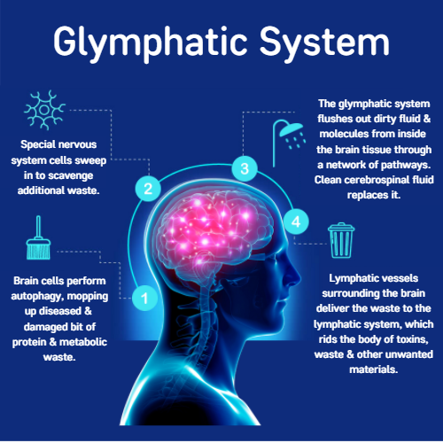
Glymphatic
5 Choices to help Glymphatic System In the Brain
  Sleep
  Exercise
  Hydrate
  Healthy Microbiome
  Adaptogens
Notes:
Sleep deprivation can worsen symptoms of amyotrophic lateral sclerosis (ALS) in mice and humans, and can also affect the disease's progression and survival time:
Sleep deprivation in mice
Sleep deprivation can cause toxic proteins to build up in the brains of mice. This is because the glymphatic system, which removes waste from the brain, is mostly inactive when we're awake.
Circadian rhythm disruption in mice
Circadian rhythm disruption (CRD) can accelerate the onset and progression of ALS in mice. CRD can also aggravate neurodegeneration and inflammation.
Stress in mice
Repeated restraint-induced stress can accelerate the progression of ALS in mice. This stress can cause increased activation of astroglia and microglia in the spinal cord.
Sleep disturbances in ALS patients
Sleep disturbances are a common symptom of ALS, and sleep disorders can worsen the disease.
ALS is a neurodegenerative disease that affects the central and peripheral nervous systems. It causes the degeneration of motor neurons, which leads to muscle atrophy, paralysis, and death. Sleep plays an important role in repairing the nervous system, so sleep-based therapy could be a potential treatment for ALS.
On your back? Side? Face-down? Mice show how we sleep may trigger or protect our brain from diseases like ALS
May 26, 2022
The Conversation
Sleep‐based therapy: A new treatment for amyotrophic lateral ...
Dec 8, 2021 — Amyotrophic lateral sclerosis (ALS) is a worldwide problem with no effective treatment. Patients usually die of respira...
Sage Journals
Circadian Rhythm Dysfunction Accelerates Disease Progression in a ...
Apr 24, 2018 — Results * CRD Accelerated Disease Onset and Progression in ALS Model Mice. As shown in Figure ​1A, the 42-day-old ALS...
National Institutes of Health (NIH) (.gov)
Show all
So maybe we are onto something here. Maybe MS is linked to the microbiome. And if it is, maybe changing the microbiome can change the progression and the severity of MS.

Slide 12
Stimulate Autophagy
Berberine: This plant alkaloid triggers autophagy in a wide range of cell types, including liver, kidney, breast, myocardium, macrophages, lung, and neuron cells.
Curcumin: Can enhance autophagy to protect cells from oxidative stress.
Pterostilbene: Can boost autophagy by regulating the levels of key proteins.
Green tea: Polyphenols in green tea can induce autophagy.
Coffee: Caffeine promotes autophagy in skeletal muscle
Extra virgin olive oil: Increases autophagy of brain cells.
Oily fish: Polyunsaturated fats in fish oils may promote autophagy.
Spermidine: found in wheat grass to stimulate autophagy.

Slide 13
Autophagy
Fasting: Prolonged fasting for two to three days can increase autophagy by depriving the body of nutrients and stressing cells.
Exercise: Physical exercise can damage cells, which triggers autophagy.
Ketogenic diet: This diet deprives the body of carbohydrates, which can increase autophagy.
Diet and Exercise4

Slide 14
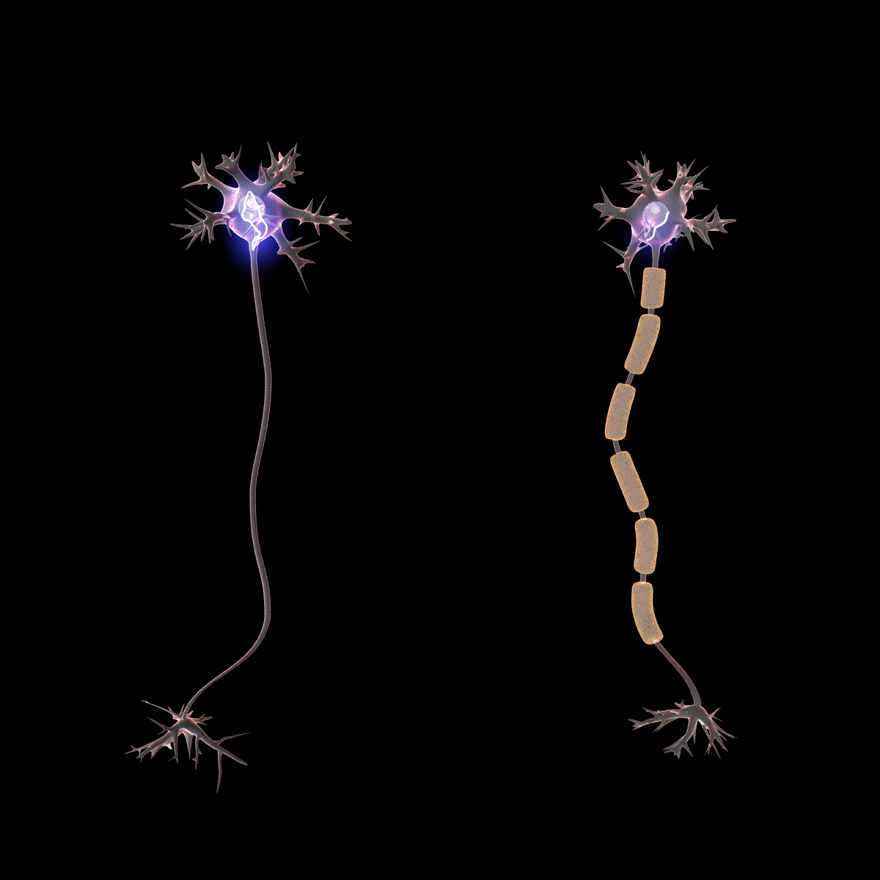
Demyelination
Impaired Autophagy and Glymphatics causes neurodegeneration
Podbielska, Maria et al. “Myelin Recovery in Multiple Sclerosis: The Challenge of Remyelination.” Brain Sciences 3.3 (2013): 1282–1324. PMC. Web. 4 Sept.2017.
Notes:
Why is this so devastating? Myelin is a fatty white substance that surrounds the axon of nerve cells, forming an electrically insulating layer. It’s essential for the proper functioning of the nervous system.
When the myelin sheath is damaged, so is neurons’ ability to conduct electrical signals. This demyelination causes a host of debilitating symptoms that can be devastating, even fatal.
But there's good news. Today I’m going to talk to you about ways we can try to accomplish two treatment goals:
The first goal is to decrease the rate of progression for the illness.
The second goal is to maximize remyelination, restoring the function of neurons and decreasing symptoms.

Slide 15
Interventions in Senescence and Autophagy
Tauroursodeoxycholic acid 500 mg
Organic Ashwagandha Root 350 mg
Nicotinamide Riboside 250 mg
Pterostilbene 100 mg

Slide 16

Asian Black Bear
TUDCA – Tauroursodeoxycholic
It is a bile acid that is found in trace amounts in the human body.
Bile acids are compounds released from the gallbladder that help digest fats.

Slide 17
TUDCA
TUDCA – Tauroursodeoxycholic is a bile acid that is found in trace amounts in the human body. Crosses the blood-brain barrier accessing neuronal tissues.
Promote healthy nerve cells
Animal bile has been used in traditional Chinese medicine for thousands of years because of its potential pharmacological action to help with longevity

Slide 18

Current clinical trial for Alzheimer's disease
involves a combination of the drugs Phenylbutyrate (PB) and Tauroursodeoxycholic Acid (TUDCA

Slide 19
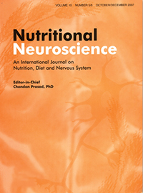
Parkinsons
A study in Nutritional Neuroscience found that pretreatment with TUDCA protected against dopaminergic neuronal damage in a model of Parkinson's disease. The study also found that TUDCA may attenuate the effects of autophagy, which may be involved in the progression of Parkinson's disease

Slide 20

Progressive MS
ongoing clinical trials investigating the use of TUDCA (tauroursodeoxycholic acid) in patients with progressive multiple sclerosis (MS),
TUDCA supplementation in individuals with low bile acid levels and progressive MS; this trial is registered as NCT03423121 on ClinicalTrials.gov.

Slide 21
TUDCA Clinical Trials
Amyotrophic lateral sclerosis (ALS)
Alzheimer’s disease
Parkinson’s disease
Huntington’s disease
Multiple Sclerosis
John Hopkins University
European Commission

Slide 22
NAD/ Nicotinamide riboside
Efficient precursor to NAD+
A coenzyme vital to cellular health and to many biological functions.
Essential to the production of energy in the body and brain.
NAD+ levels decline with age and can impact healthy neurological and cellular aging processes.
.

Slide 23
Most clinical trials investigating NR currently focus on its effects on metabolic health, neurodegenerative diseases, and aging, where autophagy is considered a relevant pathway
Clinical and Translational ReportVolume 34, Issue 3p396-407.e6March 01, 2022Open accessDownload Full Issue
The NADPARK study: A randomized phase I trial of nicotinamide riboside supplementation in Parkinson’s disease
Brage Brakedal^{1,2,9} ∙ Christian Dölle^{1,2,9} ∙ Frank Riemer^{1,3,10}∙ … ∙ Renate Grüner³ ∙ David Eidelberg⁴ ∙ Charalampos Tzoulis^{1,2,11} charalampos.tzoulis@uib.no… Show more

Slide 24
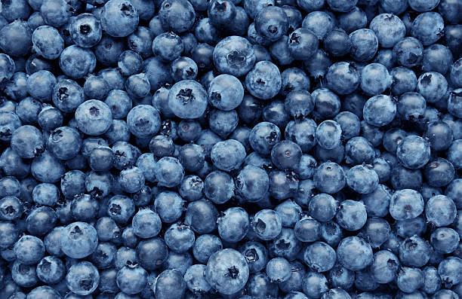
Pterostilbene induces autophagy
Stilbenes are Phenolic Compound found in many fruits such as grapes and blueberries.
Pterostilbene and resveratrol are structurally very similar and Pterostilbene has better bioavailability.
Pterostilbene reduces oxidative stress contributing to neuroprotective effects.
Pterostilbene supports cognition and working memory.
Notes:
Pterostilbene is a naturally occurring phytoalexin that can induce autophagy, which may help prevent or treat various conditions:
Cancer: Pterostilbene can inhibit the growth of cancer cells by inducing autophagy, apoptosis, and necrosis. It can also inhibit the spread of cancer cells by preventing adhesion, invasion, and metastasis. Pterostilbene can be effective against both chemosensitive and chemoresistant lung and bladder cancer cells.
Renal fibrosis: Pterostilbene can prevent renal fibrosis by inducing autophagy, which can help reduce NLRP3 inflammasome activation and epithelial-mesenchymal transition (EMT).
Skin diseases: Pterostilbene may be a therapeutic or preventive option for skin diseases.

Slide 25
PTEROSTILBENE MAY PROTECT NEURONS IN VARIOUS NEURODEGENERATIVE DISORDERS
Multiple Sclerosis
ALS

Slide 26
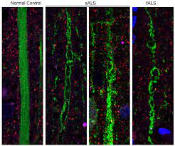
Mol Neurobiol 2021 Apr
Nicotinamide Riboside and Pterostilbene Cooperatively Delay Motor Neuron Failure in ALS SOD1G93A Mice
One human clinical trial showed that the combination of nicotinamide riboside (NR) and pterostilbene to increase the survival motor neurons in and ALS patients.
Neuroscience 2022 Apr 1
Pterostilbene Protects the Optic Nerves and Retina in a Murine Model of Experimental Autoimmune Encephalomyelitis via Activation of SIRT1 Signaling

Slide 27

Autophagy within the Lungs
Autophagy is the body’s way of cleaning out damaged cells, in order to regenerate newer, healthier cells within the cell itself

Slide 28
Impaired Autophagy Due to Smoking in COPD
The dysregulation of autophagy in COPD
Dysregulated autophagy in COPD: A pathogenic process to ...
Bose A, Beal MF. Mitochondrial dysfunction in Parkinson's disease. J Neurochem. 2016
It has been proposed that the pathology of COPD is associated with accelerated lung aging. In adults, lungs undergo a progressive decline in its ...
Notes:
Mitochondrial dysfunction is associated with both aging and a wide array of neurodegenerative disorders such as MS, Alzheimer’s disease,¹ Parkinson’s disease,² and amyotrophic lateral sclerosis (ALS).³Mitochondrial dysfunction increases with age, leading to high levels of reactive oxygen species and prolonged oxidative stress. Studies suggest that raising intracellular concentrations of NAD+ (nicotinamide adenine dinucleotide) may be crucial in this regard.^{6,7} NAD+ is an essential coenzyme and substrate in multiple biological processes including the modulation of cellular metabolism, cell signaling, transcription, and DNA repair.⁸

Slide 29

Lung Senescence
It has been proposed that the pathology of COPD is associated with accelerated lung aging. In adults, lungs undergo a progressive decline in its ...

Slide 30
COPD
70 year old male
Before: Spirometry Function 45%
After : Spirometry Function 54%
Now can walk 45 minutes versus 10 minutes
Senolytic compounds containing Fisetin and Tudca
Turmeric Curcumin Products 2 caps 5 times a day

Slide 31
Lupus Coagulation Disorder
Anti –Phospo- Lipids
50 year old male
Phospholipid IgM 9 Cardiolipin Ab
Before: 23.4 units ( negative under 15)
After: 10 units
TUDCA PX 2 caps BID for three months
Significant Less Cardiac Risk

Slide 32
Biliary dyskinesia
31 year old female
Fatigue and Cognitive Decline
TUDCA PX 2 caps BID for two weeks
Daily Cognitive Testing Done at home
Significant Improvement In Energy and Vitality and improvement in Ci=ognitive Index Score from GP

Slide 33
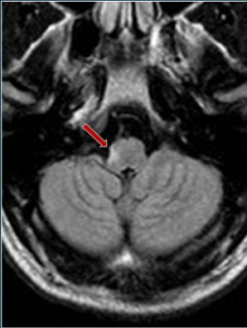
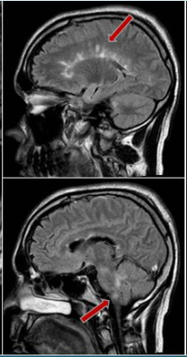
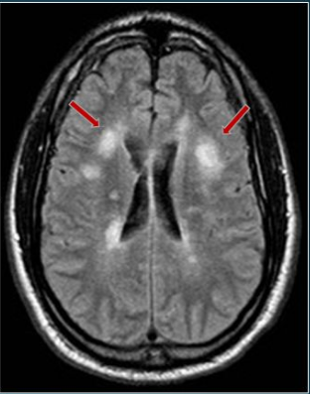
DIAGNOSIS:
MS LESIONS (MRI)
B
C
A
D
Notes:
Diagnosis of MS is made by clinical evaluation and MRI. MS demyelination, called lesions, appear as white on MRI.
Here we see images from a 40 year old MS patient who had symptoms related to cognitive function, breathing regularity, malaise and mobility. Lesions are seen in four areas.
right lateral medulla oblongata
periventricular distribution along the path of the deep medullary veins. These lesions are commonly referred to as “Dawson’s fingers”.
the upper medulla
the bilateral periventricular white matter.

Slide 34



Slide 36

Notes:
I ignored that last piece of advice.
A few weeks later I got an application for disability. I threw it in the garbage.
After all, I'm a Naturopathic Physician with many more tools in my kit. I could do all the standard autoimmune things such as
Hypoallergenic diet
Detoxification
IV Glutathione
IV Phosphatidylserine
And Vitamin D
I’d eat a hyposaturated fat diet.
And I’d get better.

Slide 38


Slide 39
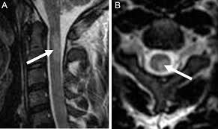
Cervical Lesion
Notes:
I was dead wrong.
9 months later, my “galaxy" of lesions in the C2 area became one consolidated large lesion.
My symptoms worsened dramatically.

Slide 40

Notes:
My surfing gloves became gloves to protect me from the searing pain of mildly warm water touching my hand during a shower.

Slide 41

Notes:
Putting my shoes on was a difficult, time-consuming event.

Slide 42

Notes:
Playing piano was impossible.
Just walking was an issue.
Even worse, I developed demyelinations and atrophy in the cerebral cortex, which is involved in executive functions, sequential thinking, and word selection.

Slide 43

Notes:
Sometimes I temporarily lost my identity. I couldn’t even remember who I was.

Slide 44

Notes:
My speech therapist gave me this to put in my wallet.

Slide 45

Notes:
One evening, I wrote this. I was feeling an attack coming on, and I was worried that I wouldn’t recognize my family.

Slide 46

Notes:
A week later, for just a minute, that came true. This is my son. But I thought maybe he might be my godson.

Slide 47

Notes:
Another lesion grew. I was offered a cup of tea. I saw 4 hands. So I was referred to the hospital.

Slide 48
Fasting
TUDCA
Nicotinamide Riboside
Pterostilbense
Ashwaganda
Goldenseal Berberine Combination
Bill Mitchel’s Fruit Anthocyanin Blend

Slide 49
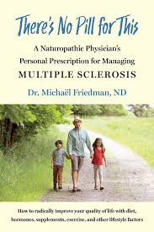
Notes:
15 consecutive MRI over 13 years have shown no further progression

